Slide 1
Redux-Form
Handle forms with Redux
Sam Zaza - LT & RG Team lead

Slide 2
Overview
The original documentation on forms management with React does not make it easy to handle complex UIs.
One solution is the library React final form.
In the redux world Redux-form is standard de-facto

Slide 3
Overview
Redux form in its basic implementation is comprised of 3 pieces:
formReducer: The reducer function that tells the store to update based on changes in the form being rendered.
reduxForm: HOC that binds user interaction to dispatch redux actions.
Field: Component that lives within reduxForm that connects the input components to the redux-form logic.

Slide 4
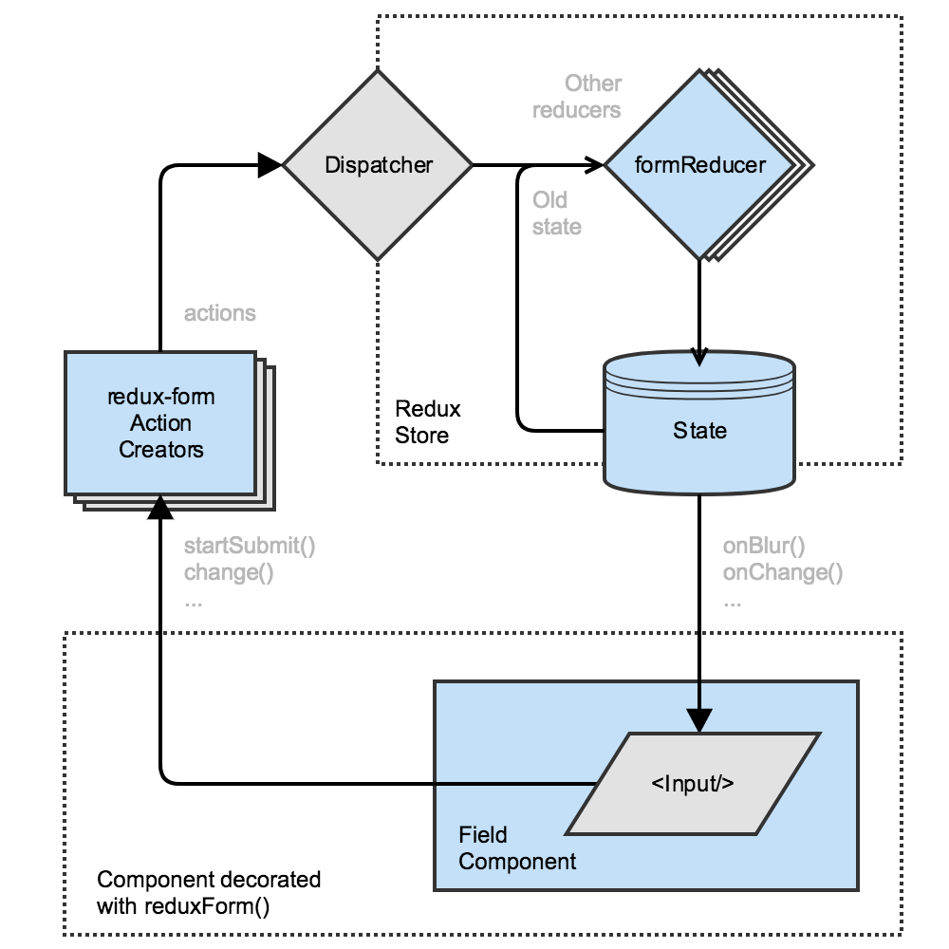
Flow
User clicks on the input,
"Focus action" is dispatched,
formReducer updates the corresponding state slice,
The state is then passed back to the input.

Slide 5

Thanks!
References:
Redux-form official documentation

